Slide 1
Generative Adversarial Network
성균관대학교 소프트웨어학과
이 지 형

Slide 2
Why Generative Models?
We’ve only seen discriminative models so far
Given an image X, predict a label Y
Estimates P(Y|X)
Discriminative models have several key limitations
Can’t model P(X), i.e. the probability of seeing a certain image
Thus, can’t sample from P(X), i.e. can’t generate new images
Generative models (in general) cope with all of above
Can model P(X)
Can generate new images

Slide 3
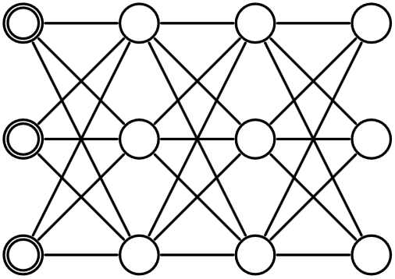
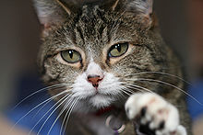

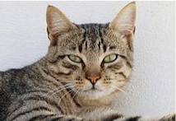
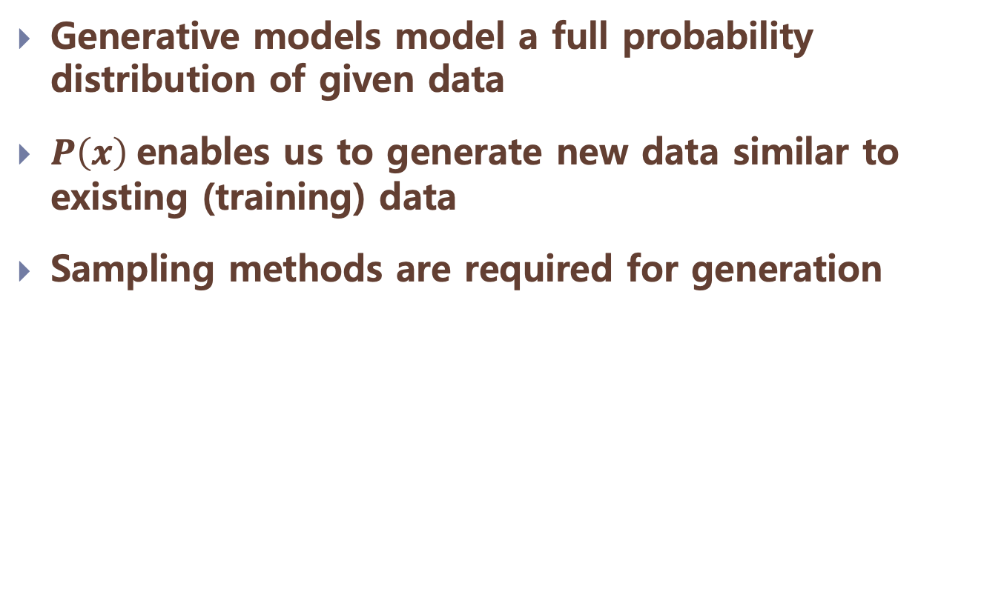
Why Generative Models?
Generative models model a full probability distribution of given data
$P\left(x\right)$enables us to generate new data similar to existing (training) data
Sampling methods are required for generation

Slide 4
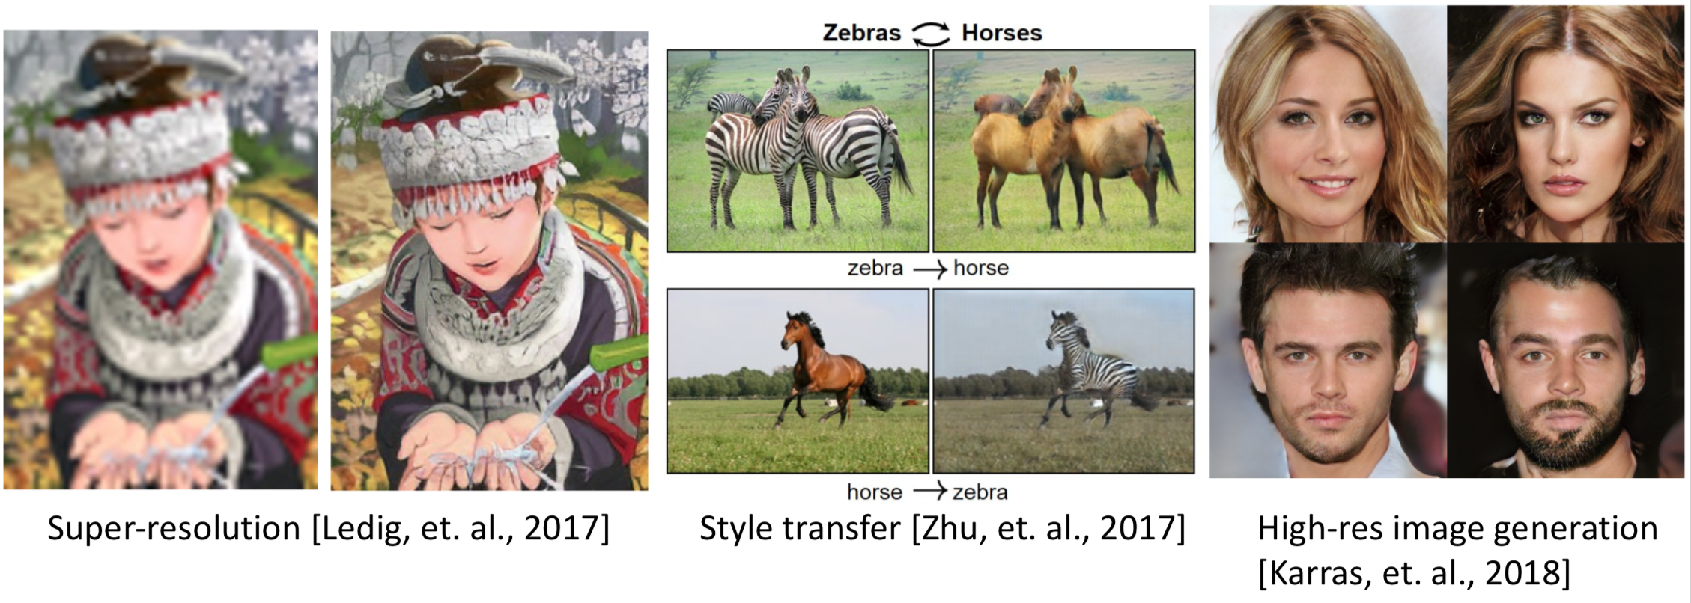
Why Generative Model?
Generate new samples from the same distribution with training data
Vision: super-resolution, style transfer, image inpainting, etc.
Audio: synthesizing audio, speech generation, voice conversion, etc.

Slide 5
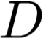
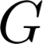
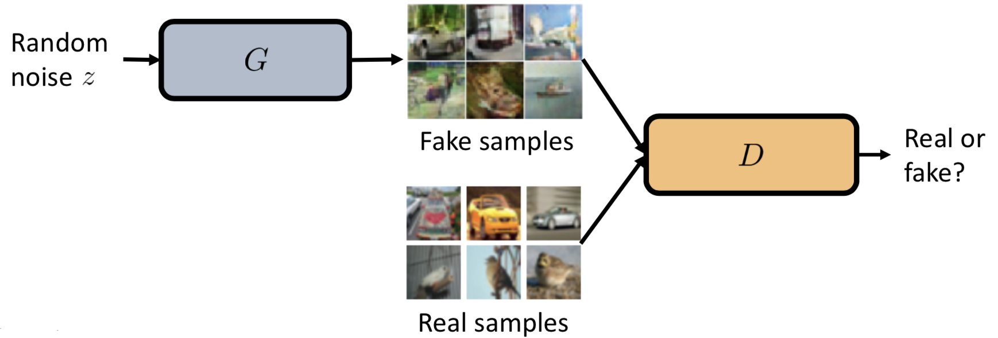
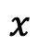
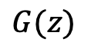
GAN
Two player game between discriminator network and generator network
D tries to distinguish real data and samples generated by (fake samples)
G tries to fool the D by generating real-looking images
$$G(z)$$
$$x$$

Slide 6
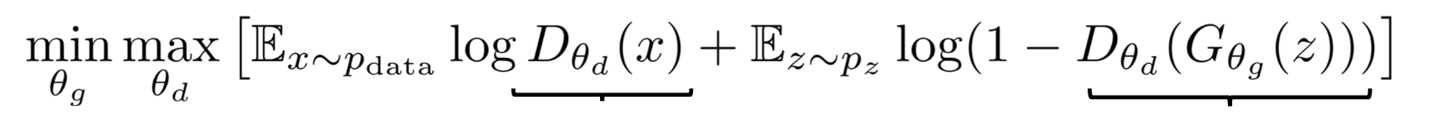
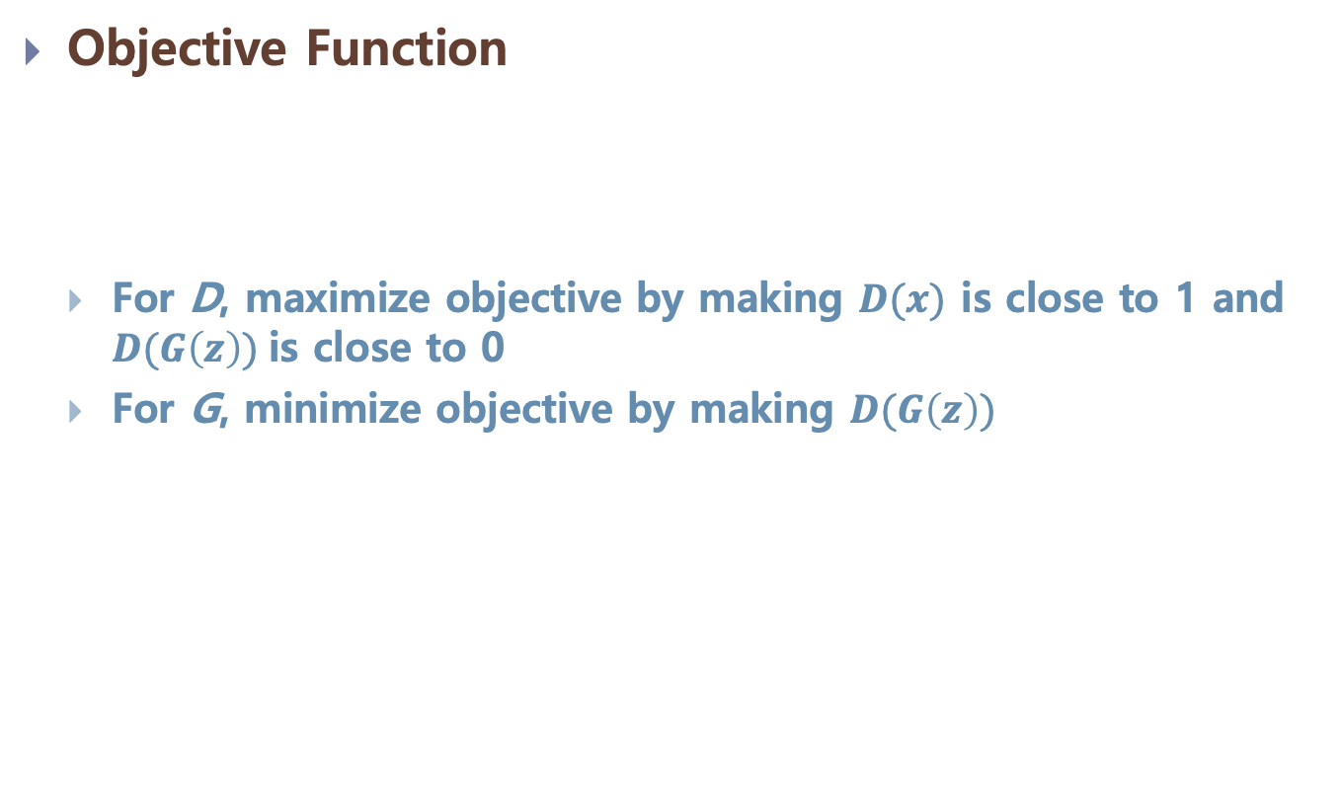
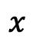
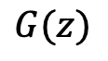
GAN
Objective Function
For D, maximize objective by making $D(x)$ is close to 1 and $D(G\left(z\right))$is close to 0
For G, minimize objective by making $D(G\left(z\right))$
$$G(z)$$
$$x$$

Slide 7
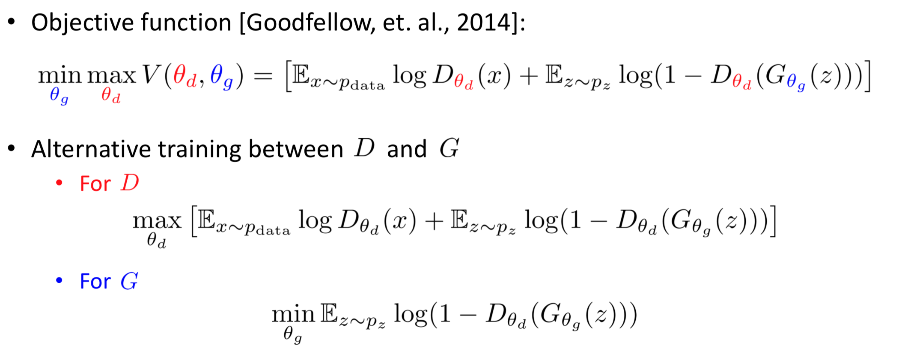
GAN
Training
Alternative training between D and G

Slide 8
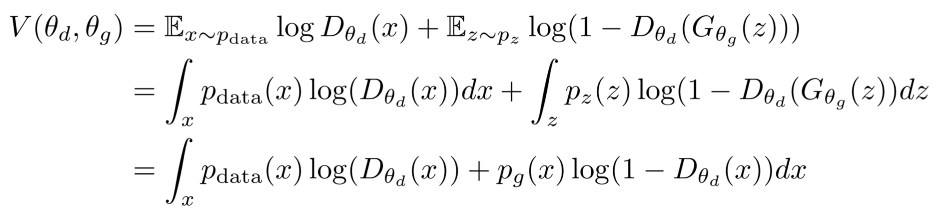
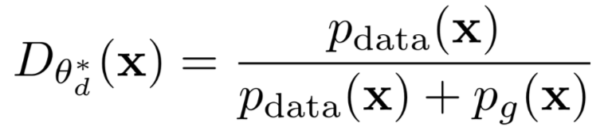
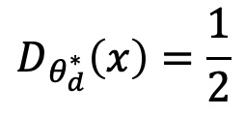
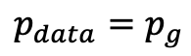
GAN
Optimal Strategy of Discriminator
For fixed G, the D minimizes:
Optimal discriminator
If , optimal discriminator:
$$D_{θ_{d}^{∗}}\left(x\right)=\frac{1}{2}$$
$$p_{data}=p_{g}$$

Slide 9
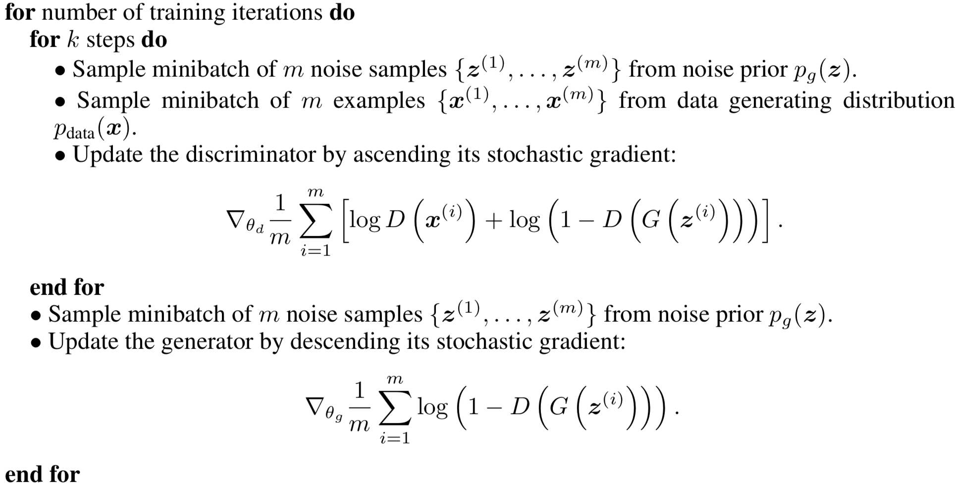
GAN
Training algorithm

Slide 10
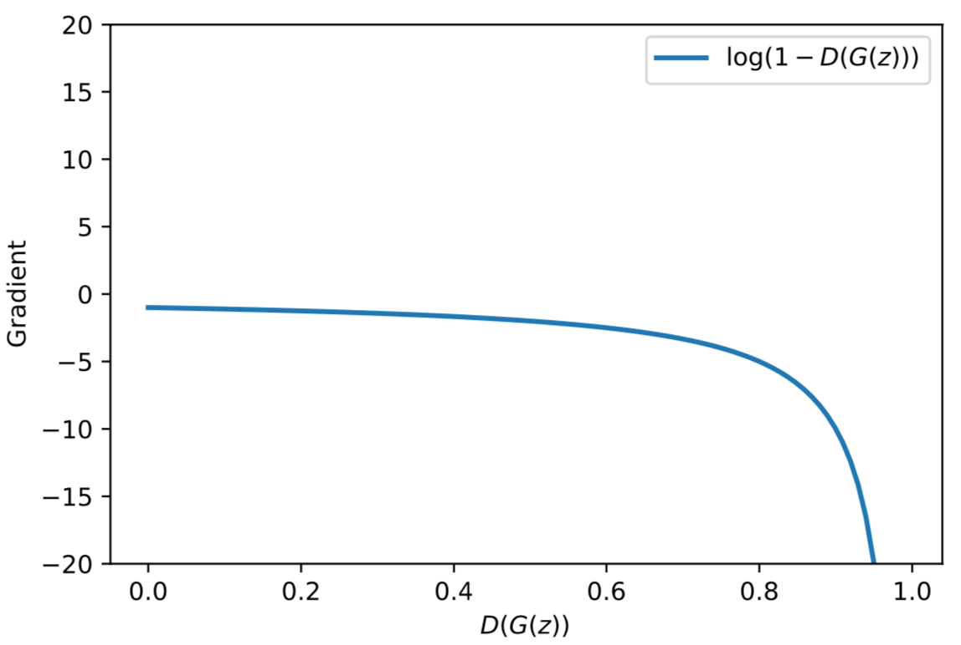
GAN
Problem in Training Generator
Optimizing generator objective does not work well
When generated sample looks bad (at the beginning of training) gradient is relatively flat

Slide 11
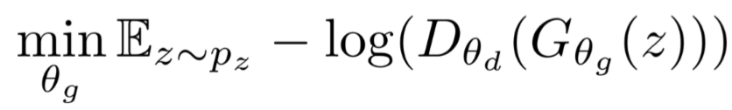
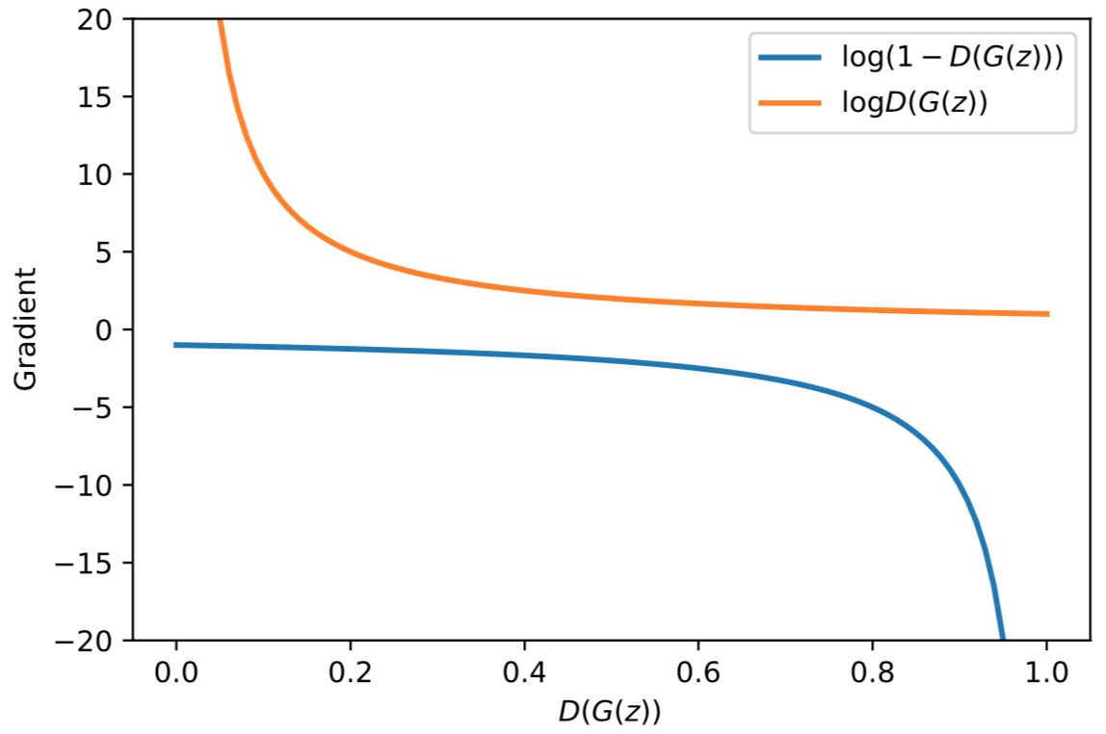
GAN
Problem in Training Generator

Slide 12
Advantage of GAN
Sampling (or generation) is straightforward.
Training doesn't involve Maximum Likelihood estimation.
Robust to Overfitting since Generator never sees the training data.
Empirically, GANs are good at capturing the modes of the distribution.

Slide 13
Issue of GAN
Hard to achieve Nash equilibrium (Optimal Solution)
GANs involve two (or more) players
Discriminator is trying to maximize its reward.
Generator is trying to minimize Discriminator’s reward.
SGD was not designed to find the Nash equilibrium of a game
Problem:
We might not converge to the Nash equilibrium at all.
$$\min_{G}{\max_{D}{V\left(D, G\right)}}$$

Slide 14
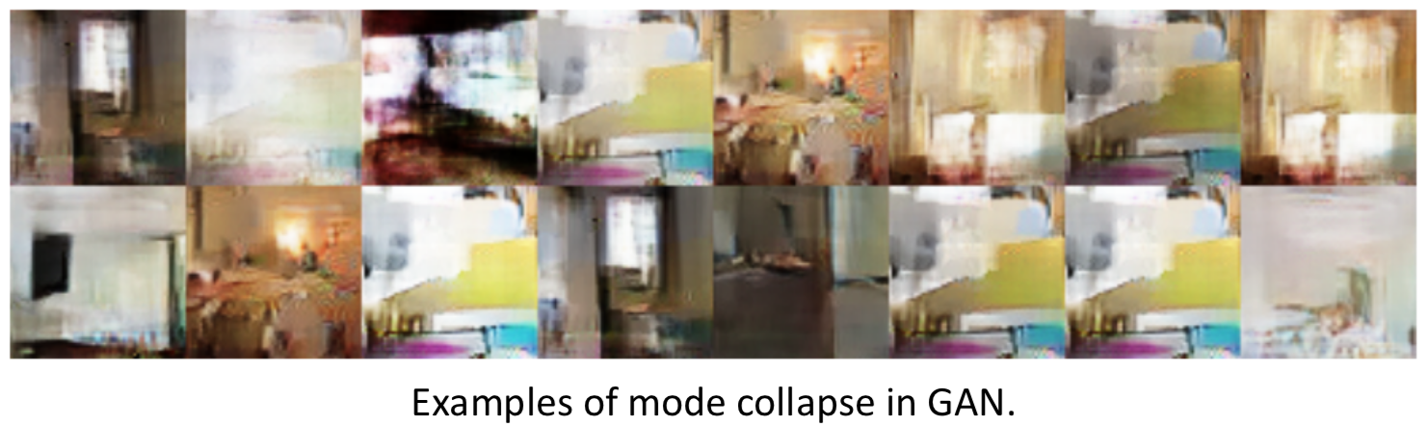
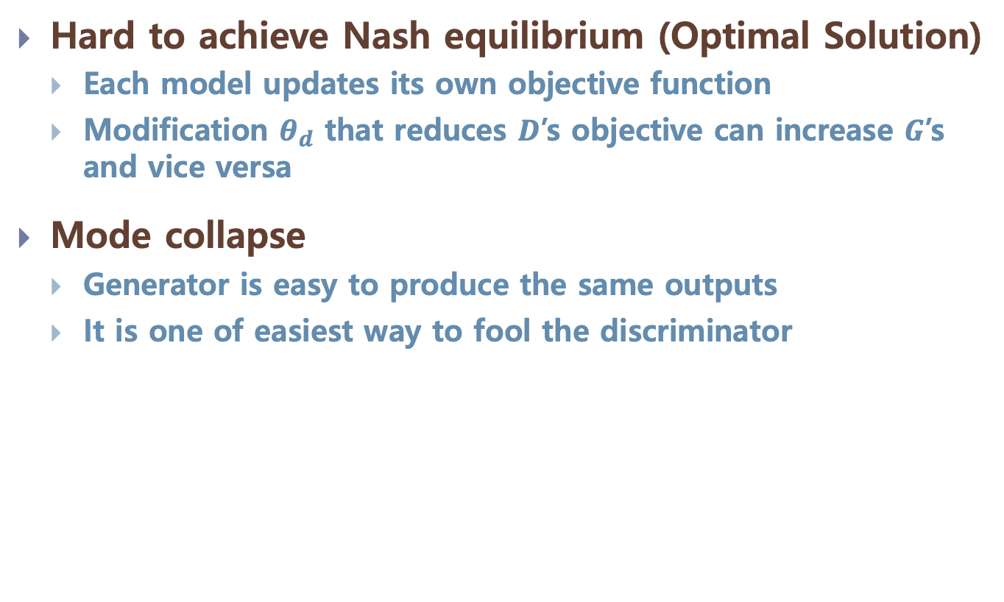
Issue of GAN
Hard to achieve Nash equilibrium (Optimal Solution)
Each model updates its own objective function
Modification $θ_{d}$ that reduces $D$’s objective can increase $G$’s and vice versa
Mode collapse
Generator is easy to produce the same outputs
It is one of easiest way to fool the discriminator

Slide 15
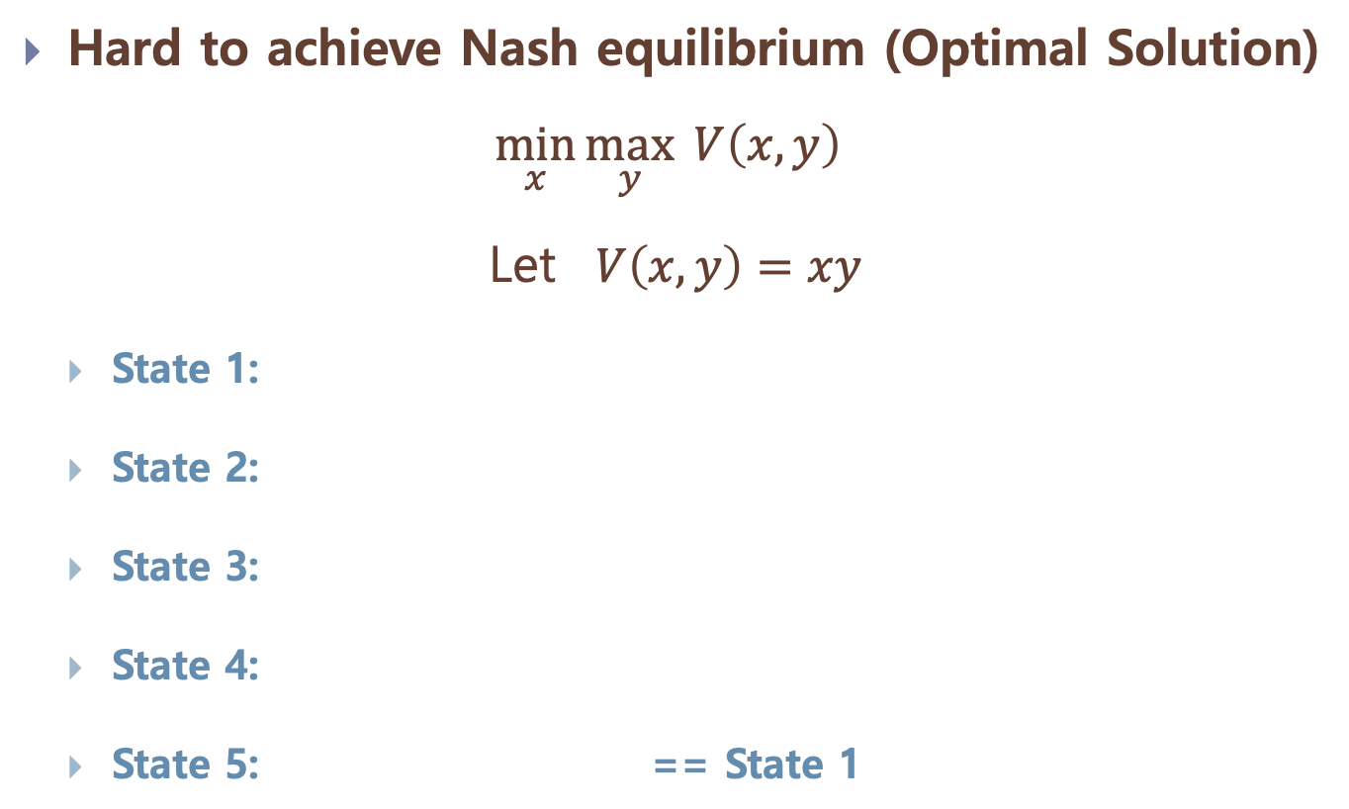
Issue of GAN
Hard to achieve Nash equilibrium (Optimal Solution)
$\min_{x}{\max_{y}{ V\left(x, y\right)}}$
Let $V\left(x, y\right)=xy$
State 1:
State 2:
State 3:
State 4:
State 5: == State 1
x > 0 | y > 0 | V > 0
Increase y | Decrease x
x < 0 | y > 0 | V < 0
Decrease y | Decrease x
x < 0 | y < 0 | V > 0
Decrease y | Increase x
x > 0 | y < 0 | V < 0
Increase y | Increase x
x > 0 | y > 0 | V > 0
Increase y | Decrease x

Slide 16
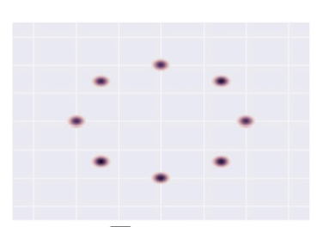
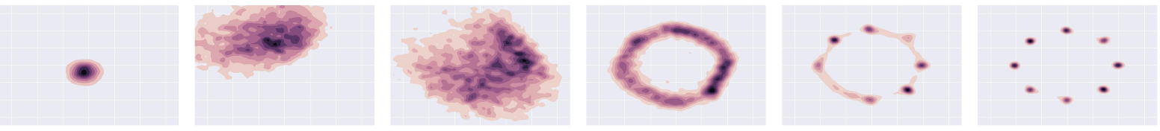
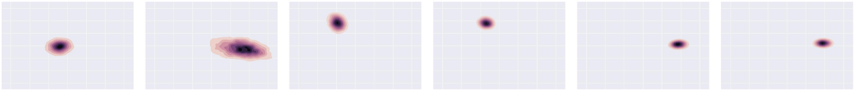
Issue of GAN
Mode-Collapse
Generator fails to output diverse samples
Target
Expected
Output

Slide 17
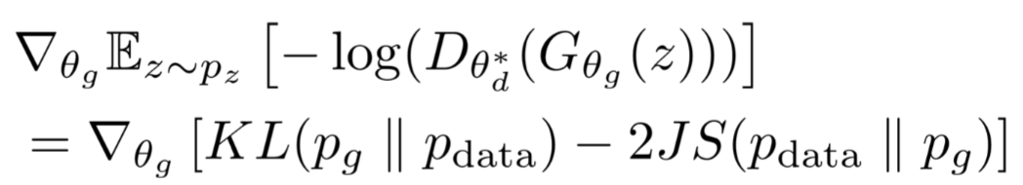
Issue of GAN
Mode-Collapse
Objective of Generator
For optimal discriminator
=

Slide 18
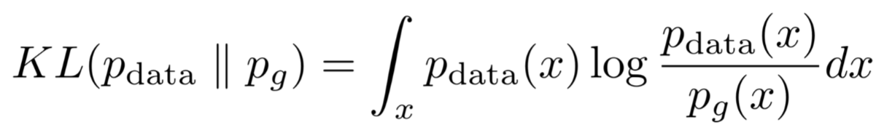
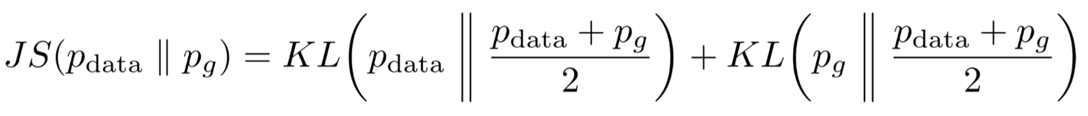
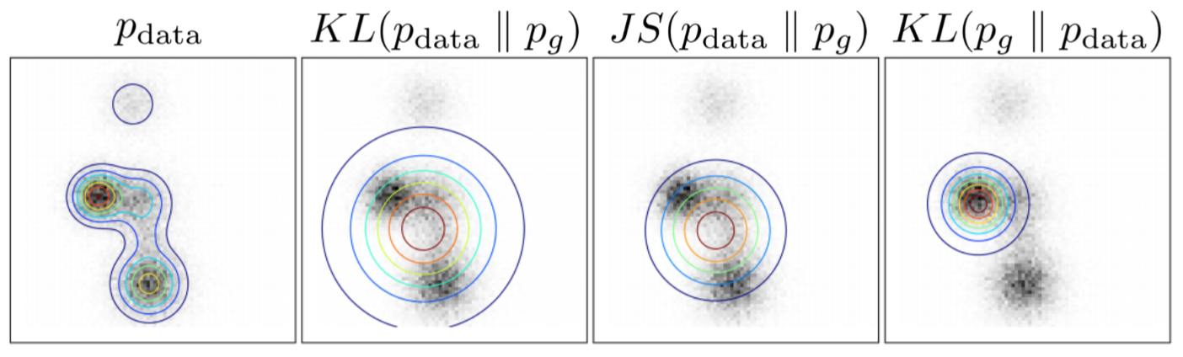
Issue of GAN
KL divergence
Jensen-Shannon divergence
Help to generate
sharp image
Allow mode-collapse

Slide 19
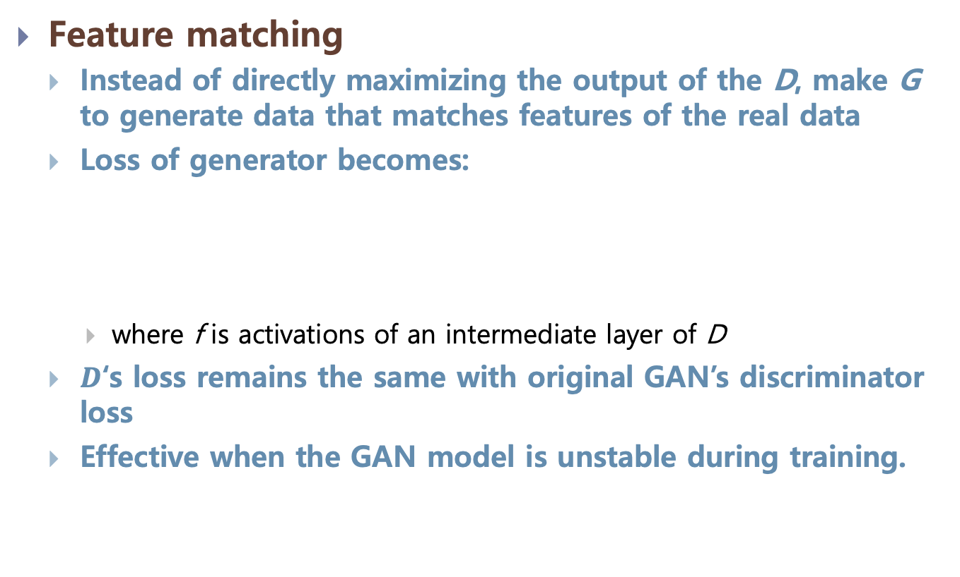
Improving Techniques
Feature matching
Instead of directly maximizing the output of the D, make G to generate data that matches features of the real data
Loss of generator becomes:
where f is activations of an intermediate layer of D
$D$‘s loss remains the same with original GAN’s discriminator loss
Effective when the GAN model is unstable during training.

Slide 20
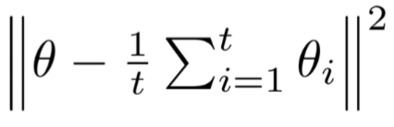
Improving Techniques
Historical averaging
Keep track of the model parameters for the last t models.
Add additional loss term to penalize model different from the historical average.
For GANs with non-convex object function, historical averaging may stop models circle around the equilibrium point and act as a damping force to converge the model.

Slide 21
Improving Techniques
Minibatch Discrimination
When mode collapses, all images created looks similar.
Feed real images and generated images into the discriminator separately in different batches
Compute the similarity of the image x with images in the same batch.
Append the similarity o(x) in the discriminator to classify whether this image is real or generated.
https://towardsdatascience.com/gan-ways-to-improve-gan-performance-acf37f9f59b

Slide 22
Various Types of GAN

Slide 23
InfoGAN
Entangled vs. Disentangled
Can we interpret the meaning of z?
If we continuously change z, does the generated image semantically continuously changes?
$$z_{2}$$
$$z_{2}$$
$$z_{1}$$
$$z_{1}$$

Slide 24
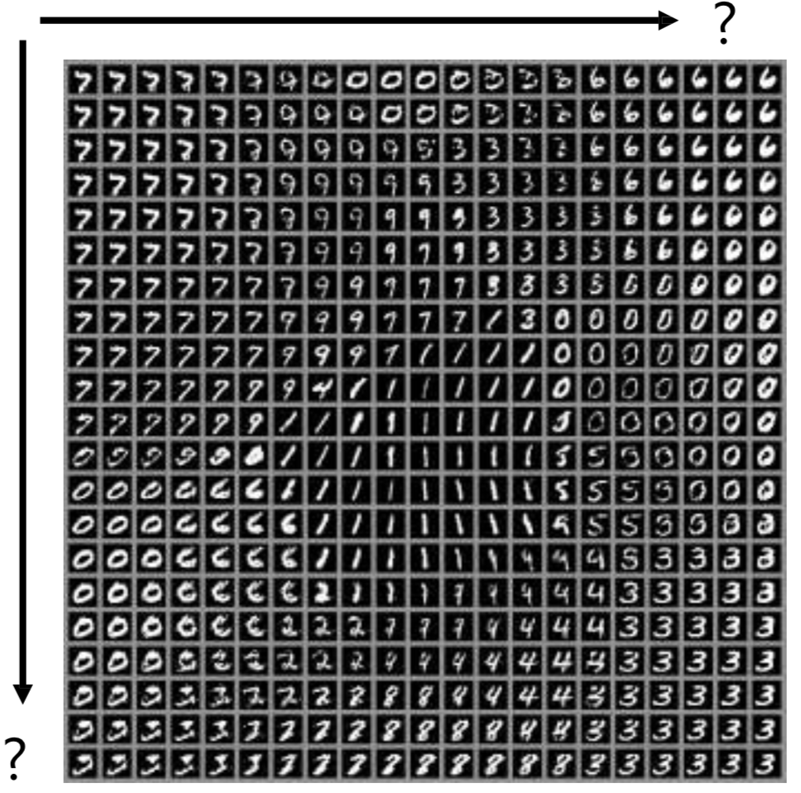
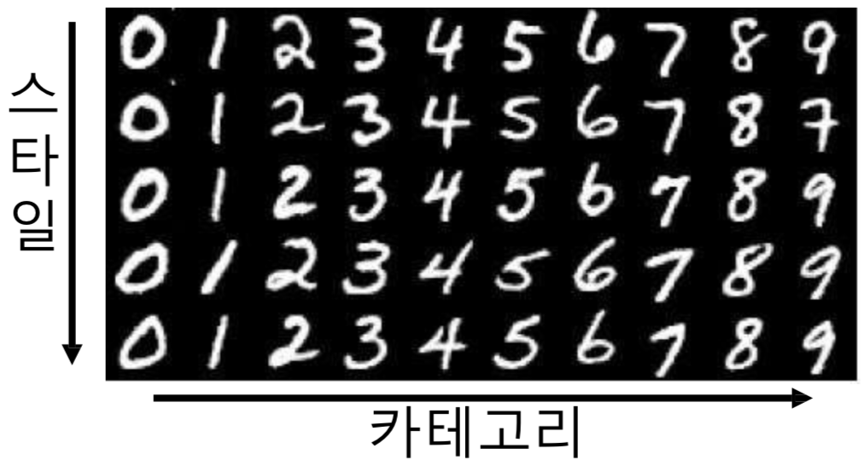
InfoGAN
Entangled vs. Disentangled
$$z_{1}$$
$$z_{2}$$
$$z_{2}$$
$$z_{1}$$

Slide 25
InfoGAN
How to reward Disentanglement?
Disentanglement means individual dimensions independently capturing key attributes of the image
Let’s partition the noise vector into 2 parts :-
z vector will capture slight variations in the image
c vector will capture the main attributes of the image
For e.g. Digit, Angle and Thickness of images in MNIST
If c vector captures the key variations in the image, Will c and 𝒙_𝒇𝒂𝒌𝒆 be highly correlated or weakly correlated?

Slide 26
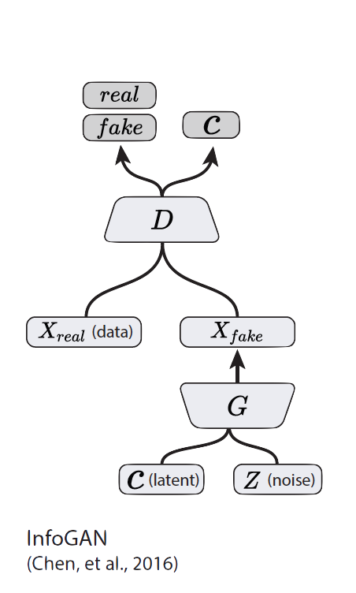
InfoGAN

Slide 27
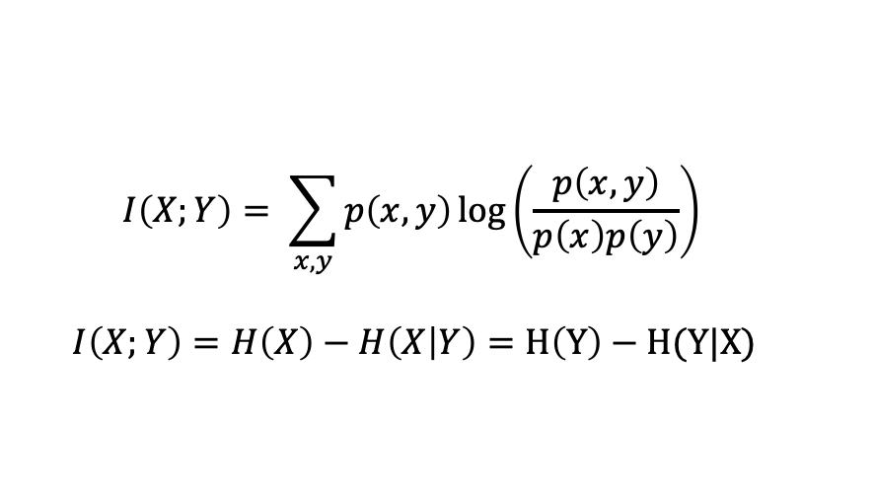
InfoGAN
We want to maximize the mutual information 𝐼 between 𝒄 and 𝐱=𝑮(𝒛,𝒄)
Incorporate in the value function of the minimax game.
$$I\left(X;Y\right)= \sum_{x,y}{p\left(x,y\right)\log\left(\frac{p\left(x,y\right)}{p\left(x\right)p\left(y\right)}\right)}$$
$$I\left(X;Y\right)=H\left(X\right)−H\left(X | Y\right)=H\left(Y\right)−H(Y|X)$$
$$\min_{G}{\max_{D}{V_{I}\left(D,G\right)=V\left(D,G\right) −λ I\left(c;G\left(z,c\right)\right)}}$$

Slide 28
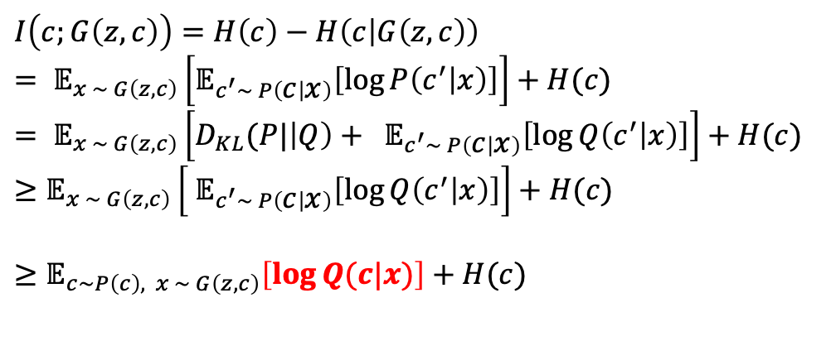
InfoGAN
Mutual Information’s Variational Lower bound
$$I\left(c;G\left(z,c\right)\right)=H\left(c\right)−H\left(c | G\left(z,c\right)\right)$$
$$= 𝔼_{x \sim G\left(z,c\right)}\left[𝔼_{c^{′}\sim P\left(c | x\right)}\left[\log{P\left(c^{′} | x\right)}\right]\right]+H(c)$$
$$= 𝔼_{x \sim G\left(z,c\right)}\left[{D_{KL}(P|\left|Q\right)+ 𝔼}_{c^{′}\sim P\left(c | x\right)}\left[\log{Q\left(c^{′} | x\right)}\right]\right]+H(c)$$
$$≥𝔼_{x \sim G\left(z,c\right)}\left[{ 𝔼}_{c^{′}\sim P\left(c | x\right)}\left[\log{Q\left(c^{′} | x\right)}\right]\right]+H(c)$$
$$≥𝔼_{c\sim P\left(c\right), x \sim G\left(z,c\right)}\left[\log{Q(c|x)}\right]+H(c)$$

Slide 29
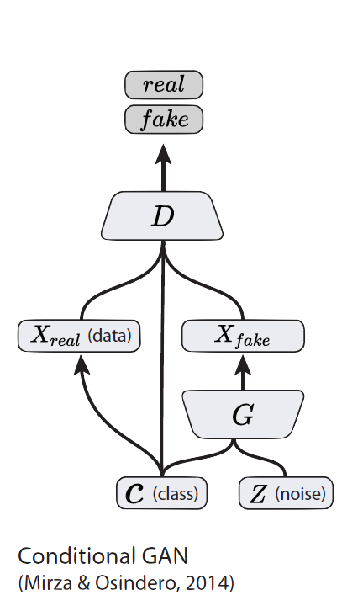
Conditional GAN
Simple modification to the original GAN framework that conditions the model on additional information for better multi-modal learning.
Lends to many practical applications of GANs when we have explicit supervision available.
Provide an effective way to handle many complex domains without worrying about designing structured loss functions explicitly.

Slide 30
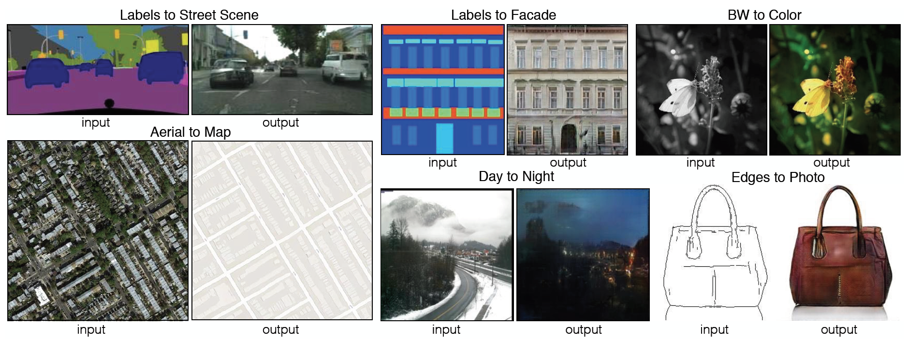
Image-to-Image Translation

Slide 31
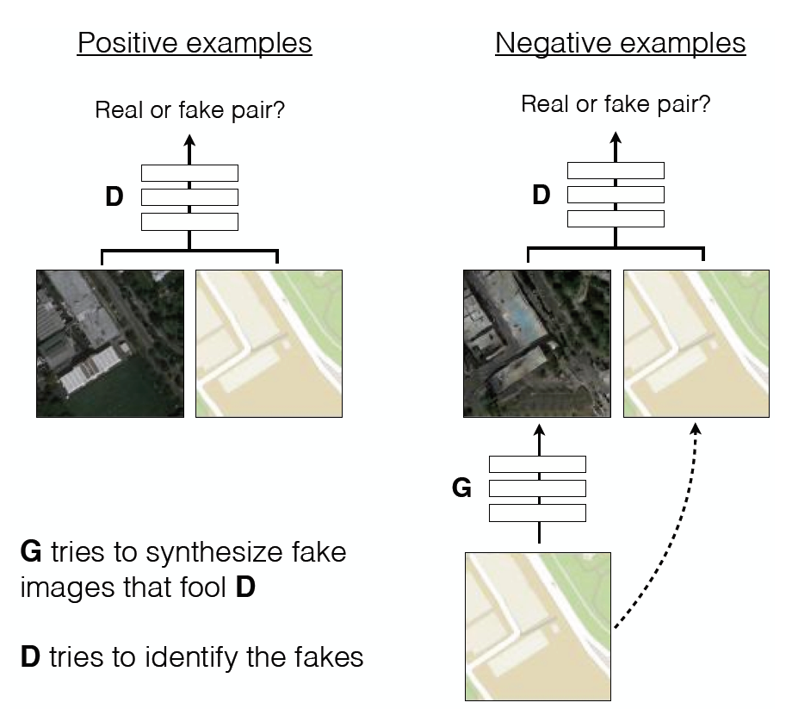
Image-to-Image Translation

Slide 32
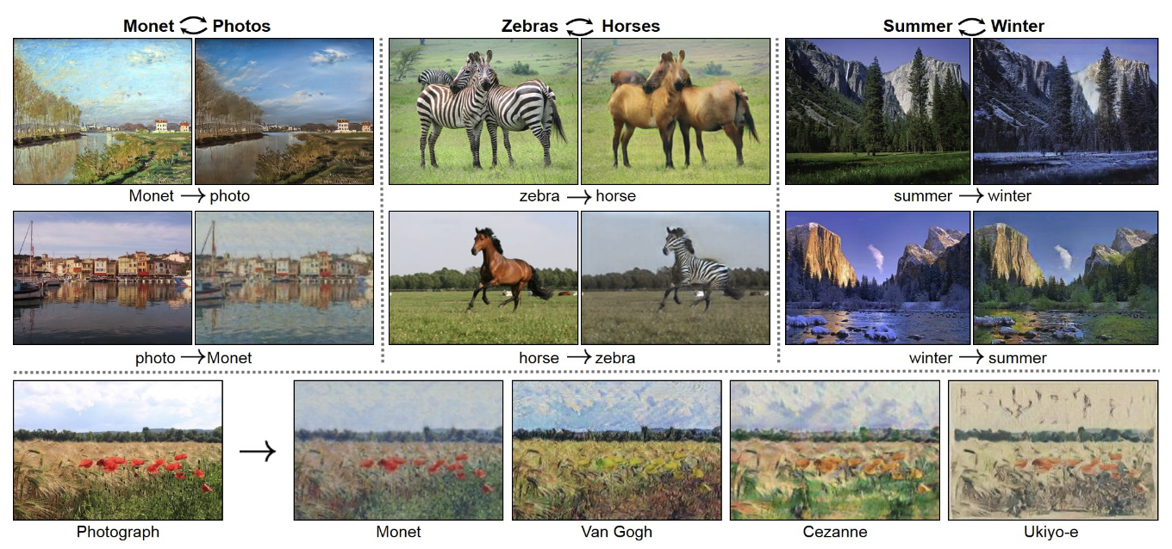
CycleGAN
Style transfer problem
change the style of an image while preserving the content.

Slide 33
CycleGAN
If we had paired data (same content in both styles), this would be a supervised learning problem. But this is hard to find.
The CycleGAN architecture learns to do it from unpaired data.
Train two different generator nets to go from style 1 to style 2, and vice versa.
Make sure the generated samples of style 2 are indistinguishable from real images by a discriminator net.
Make sure the generators are cycle-consistent: mapping from style 1 to style 2 and back again should give you almost the original image.

Slide 34
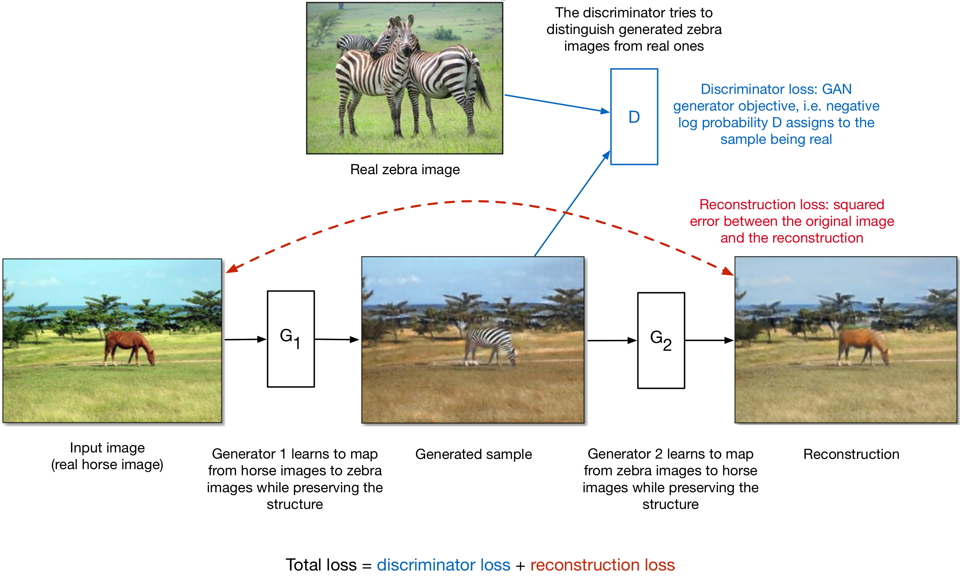
CycleGAN

Slide 35
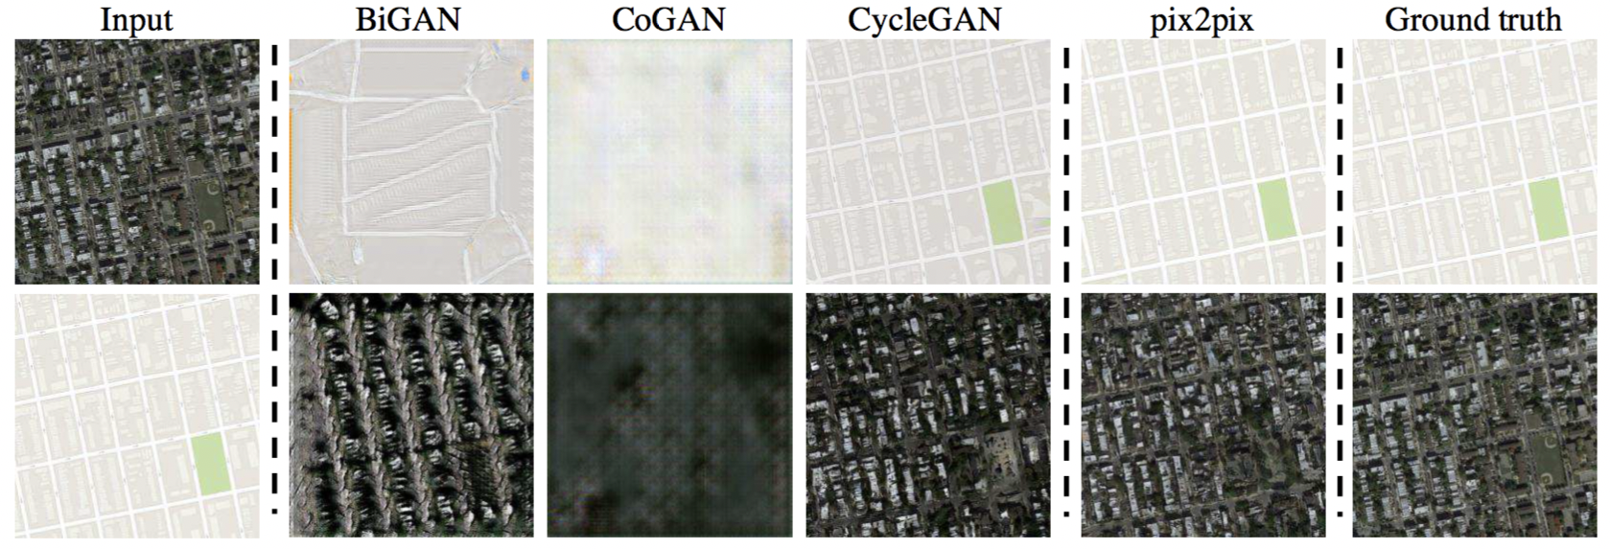
CycleGAN
Style transfer between aerial photos and maps

Slide 36
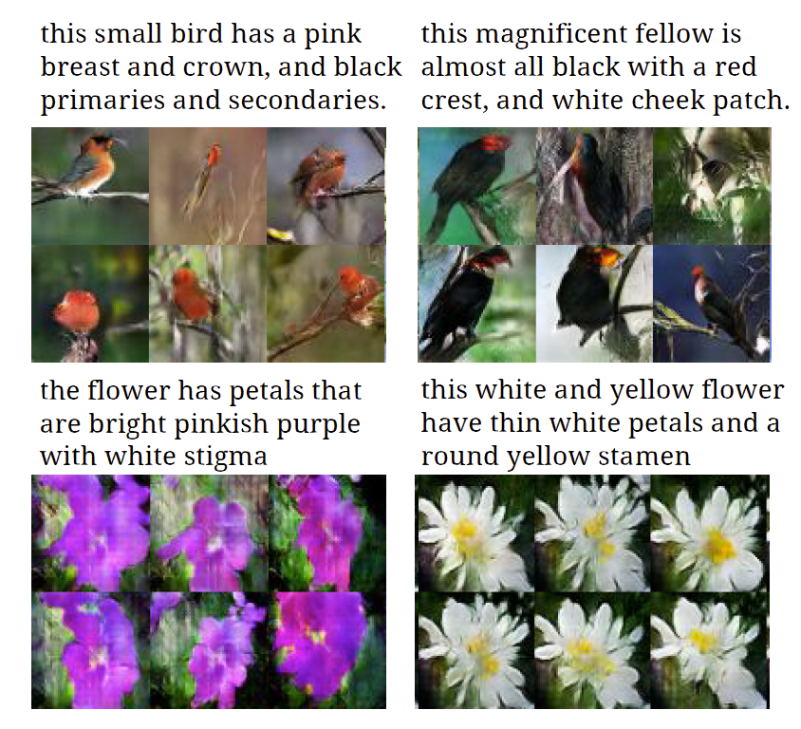
Text-to-Image Synthesis
Motivation
Given a text description, generate images closely associated.
Uses a conditional GAN with the generator and discriminator being condition on “dense” text embedding.

Slide 37
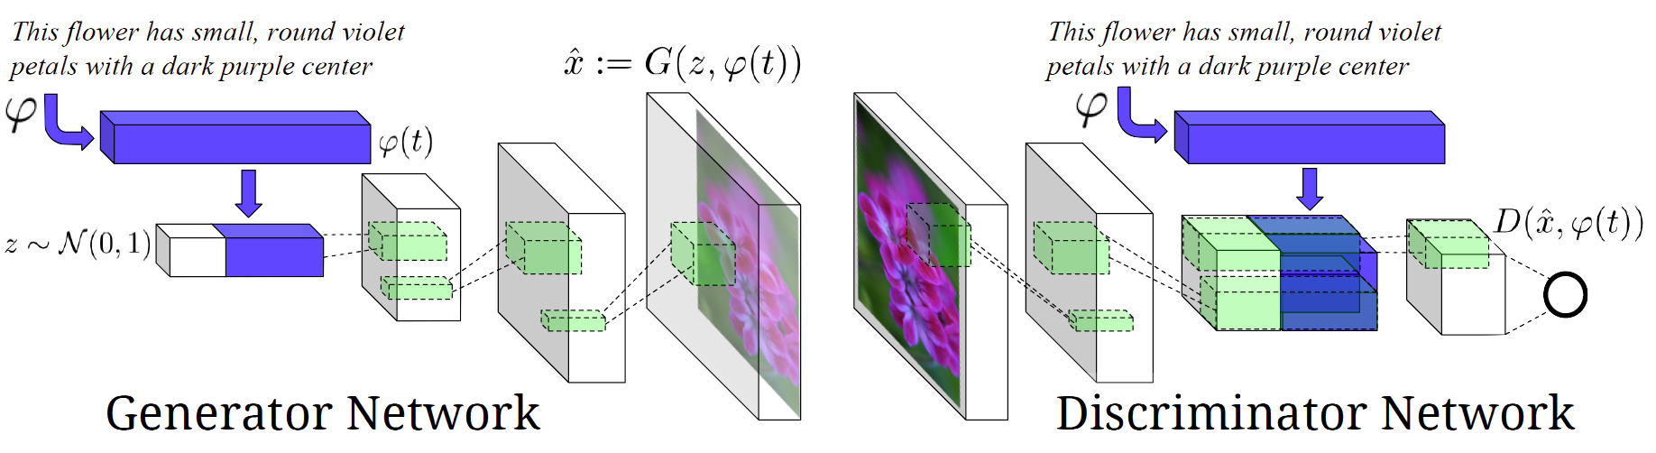
Text-to-Image Synthesis
Positive Example:
(Real Image, Right Text)
Negative Examples:
(Real Image, Wrong Text)
(Fake Image, Right Text)

Slide 38
Progressive GAN (High-Res. Image Gen.)
GANs produce sharp images
But only in fairly small resolutions and with somewhat limited variation
Training continues to be unstable despite recent progress
Generating high resolution image is difficult
It is easier to tell the generated images from training images in high-res images [Karras, et. al., 2018]
Grow both generator and discriminator progressively
Start learning from easier low-resolution images
Add new layers that introduce higher-resolution details as the training progress

Slide 39
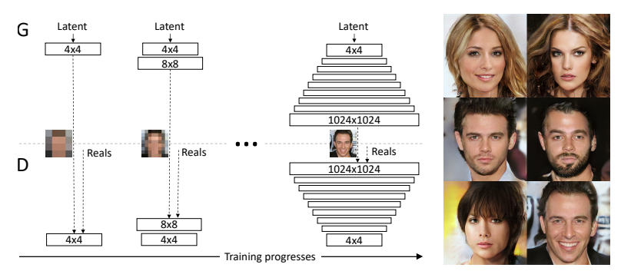
Progressive GAN (High-Res. Image Gen.)

Slide 40
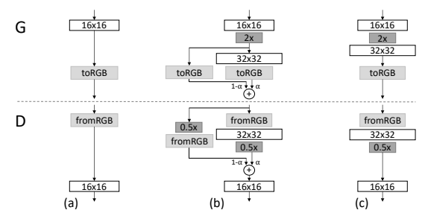
Progressive GAN (High-Res. Image Gen.)
Fade in the new layers smoothly
Prevent sudden shocks to the already well-trained, smaller-resolution layers
Transition from 16 × 16 images (a) to 32 × 32 images (c). During the transition (b) we treat the layers that operate on the higher resolution like a residual block, whose weight α increases linearly from 0 to 1

Slide 41

Progressive GAN (High-Res. Image Gen.)
1024x1024 images generated using the CELEBA-HQ dataset

Slide 42
Why GAN?
Can be trained using back-propagation for Neural Network based Generator/Discriminator functions.
Sharper images can be generated.
Faster to sample from the model distribution: single forward pass generates a single sample.

Slide 43
Summary
GANs are generative models that are implemented using two stochastic neural network modules: Generator and Discriminator.
Generator tries to generate samples from random noise as input
Discriminator tries to distinguish the samples from Generator and samples from the real data distribution.
Both networks are trained adversarially (in tandem) to fool the other component. In this process, both models become better at their respective tasks.

Slide 44
Question and Answer

